Slide 1

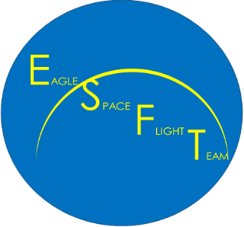


Eagle Space Flight Team
Structures Team
Nicole Shriver
shrivern@my.erau.edu
Mentor: Jacob Zwick

Slide 2
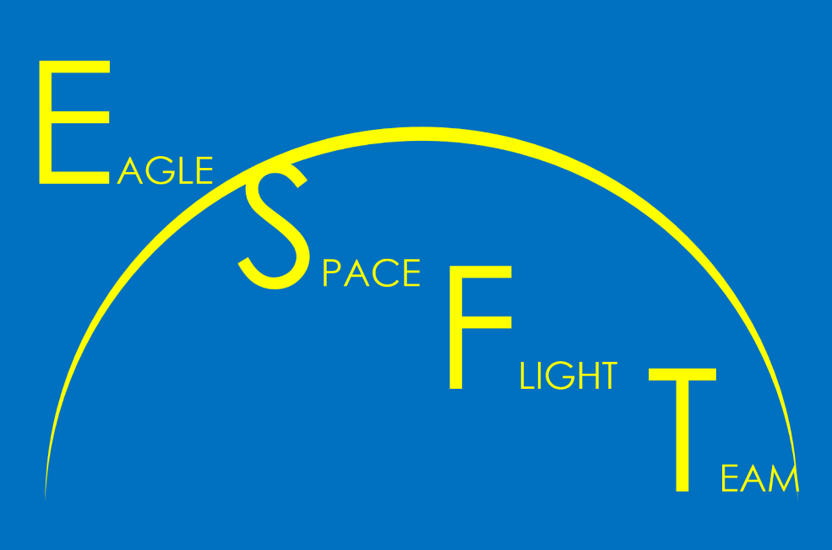
Outline
About Structures Team
Primary Objectives
Vehicle Design
Airframe Component
Recovery Component
Testbed Rocket Goals
Testing

Slide 3
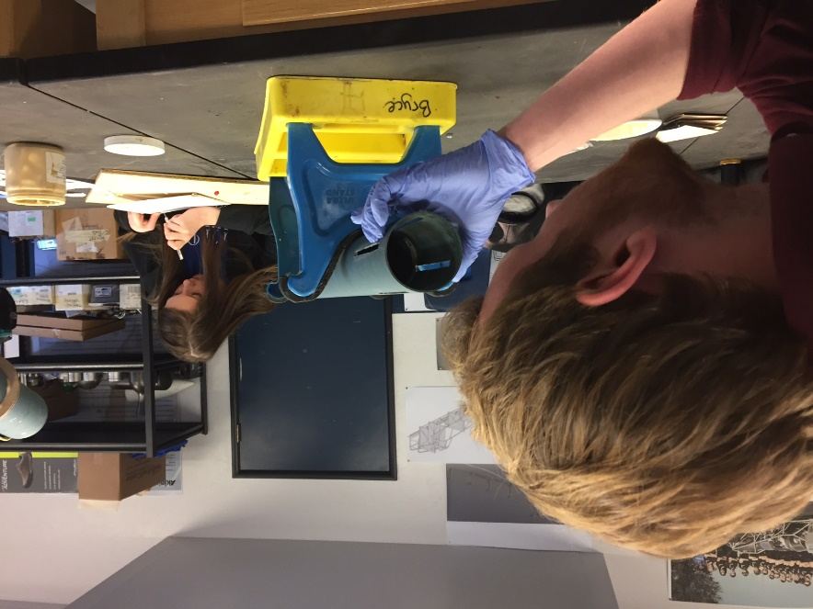
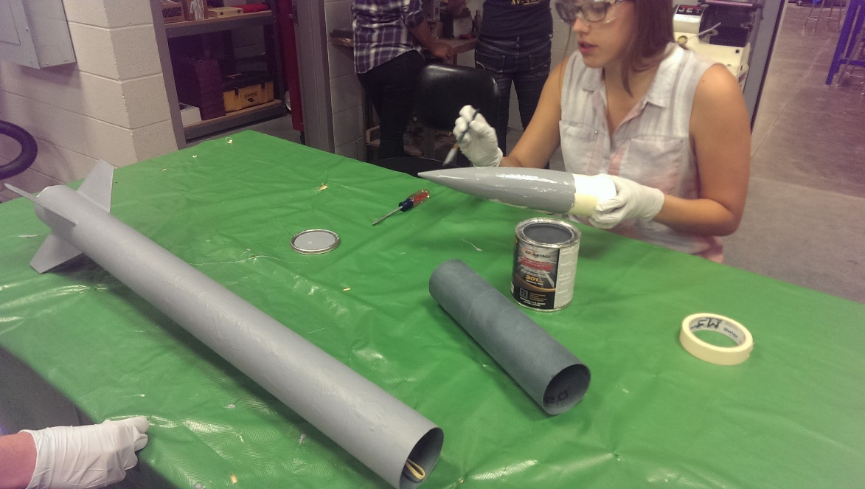
About Structures Team
Physical components of the rockets
Design, analysis, construction, and testing of the space vehicle and all those leading to it

Slide 4
Primary Objectives
The Structures Subsystem should transport less than 10 kilograms of payload.
At least 50 percent of the Structures Subsystem should be reusable.
The Structures Subsystem should survive the predicted thermal profile.
SpaceShotOne should be recovered in a safe manner.

Slide 5
Vehicle Design
Structures Subteam
Airframe Component
Recovery Component

Slide 6
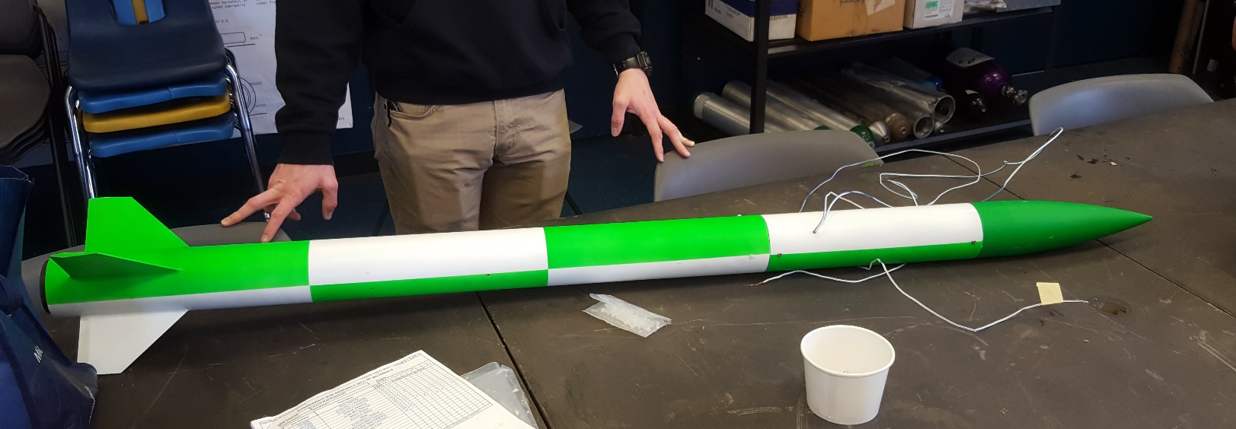
Airframe Component
Structural and thermal analysis of the rocket

Slide 7
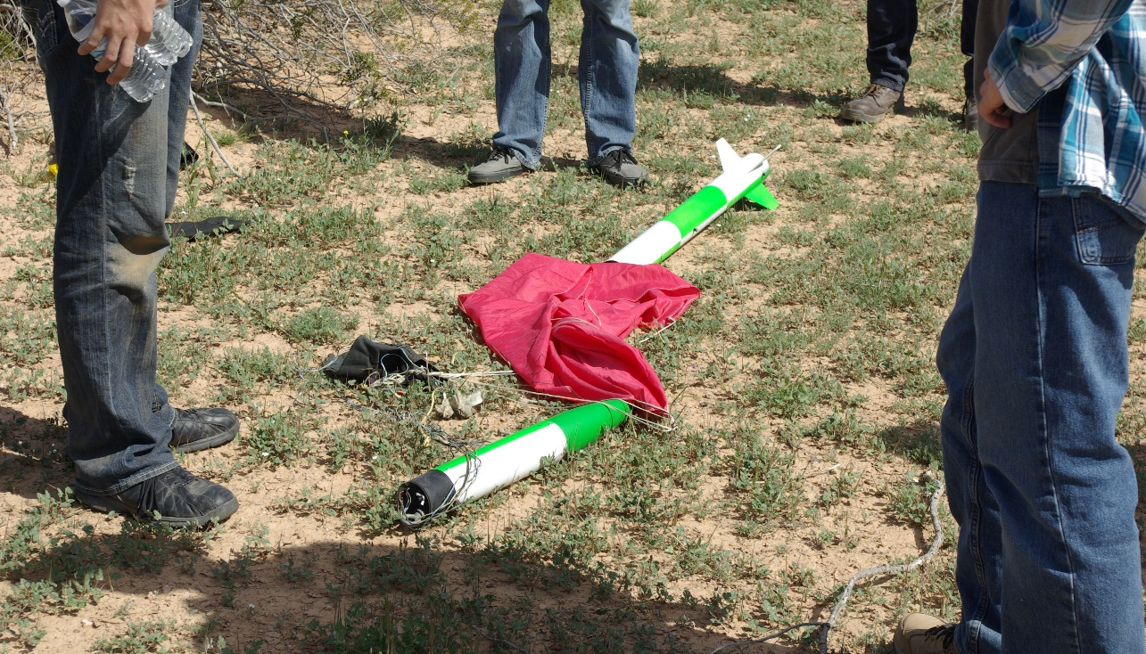
Recovery Component
Ensures that the rocket will be recovered safely

Slide 8
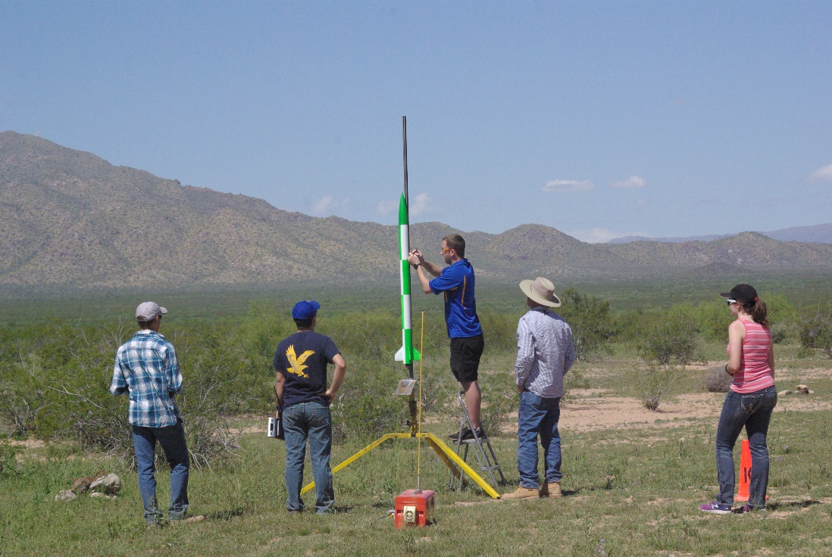
Testbed Rocket Goals
To provide a vehicle that allows for testing of electronic components and data gathering to validate aerodynamic models.

Slide 9
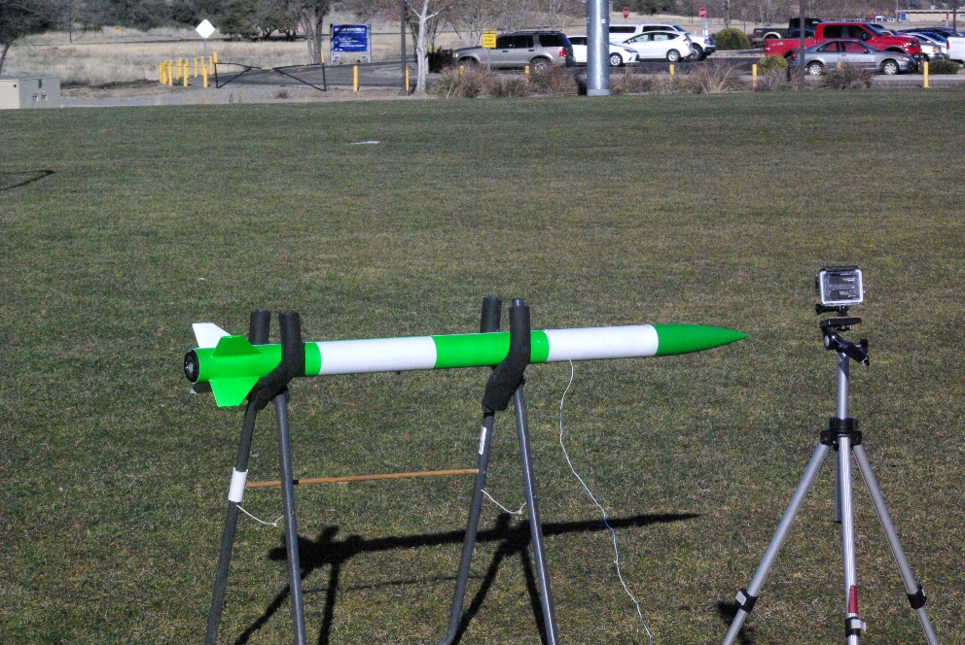
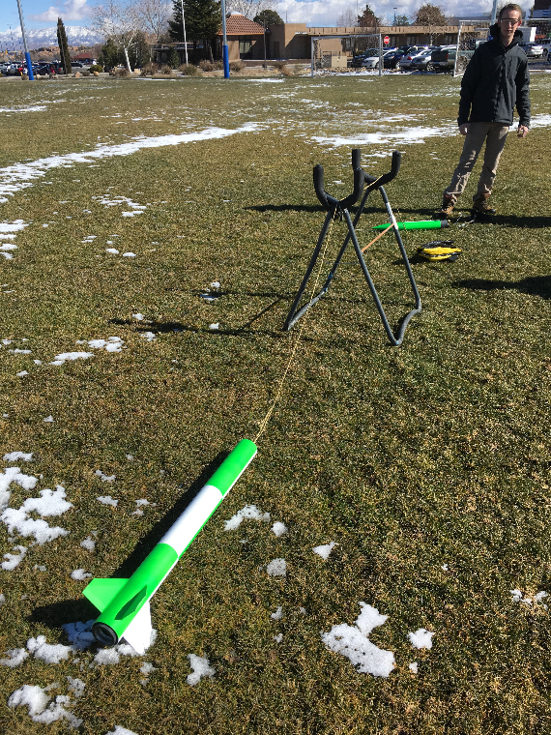
Testing
Ensure parachutes will deploy
Testing will ensure mission success

Slide 10
Acknowledgements
Jacob Zwick
Julio Benavides
Benjamin Bahr
Loren Bahr
Reece Cabanas
Alex Collins
Daniel Dyck
Daniel Griffith
Robert Hagen
Allyson McClellan
Tristan Minkoff
Xander Pickard
Cameron Ralphs
Chad Reinart
Nina Rogerson
Adam Scott

Slide 11
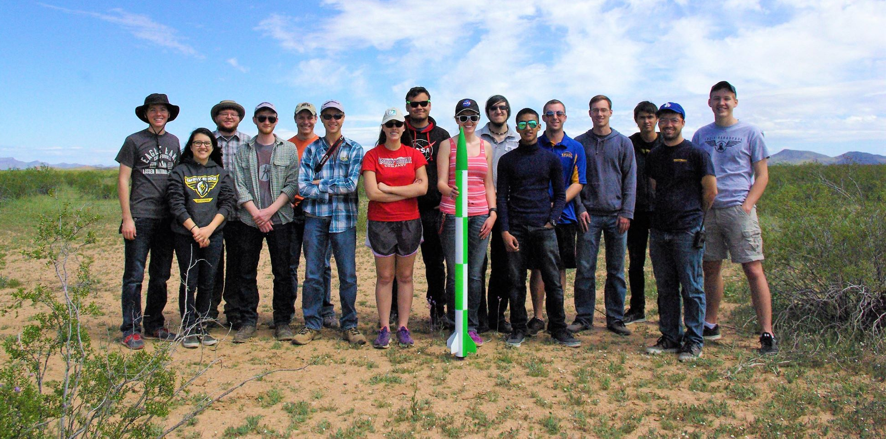
Questions
Nicole Shriver
shrivern@my.erau.edu

